Slide 1
Digital Portfolio
STUDENT NAME: RITHIKA.V
REGISTER NO AND NMID: 222410739/045BB9730283BEABEF949412AD605A91
DEPARTMENT: 2nd BSC COMPUTER SCIENCE
COLLEGE: COLLEGE/ UNIVERSITY:PERI COLLEGE OF ARTS AND SCIENCE/MADRAS UNIVERSITY

Slide 2
PROJECT TITLE
“My Digital Showcase” – simple and professional.
“Rithika’s Creative Hub” – personal branding style.
“Innovations & Inspirations” – highlights your work and ideas.
“Code & Creativity Portfolio” – ideal if your work involves programming.
“Projects That Speak” – emphasizes results and projects.
“The Art of Development” – good if mixing design and coding.
“Rithika’s Professional Journey” – formal and clean for career-focused portfolio.
“Skills in Action” – showcases practical abilities.
“Digital Footprint” – modern, tech-savvy vibe.
“From Ideas to Execution” – emphasizes the process behind your work.

Slide 3


AGENDA
Problem Statement
Project Overview
End Users
Tools and Technologies
Portfolio design and Layout
Features and Functionality
Results and Screenshots
Conclusion
Github Link
3/21/2024 Annual Review

Slide 4

PROBLEM STATEMENT
Many students and professionals struggle to effectively showcase their skills, projects, and achievements in a structured and visually appealing way. Traditional resumes or word documents often fail to highlight creativity, technical abilities, and project work in an interactive manner. There is a need for a digital portfolio that provides a centralized platform to present work, skills, and achievements in a professional and engaging format, making it easier for potential employers, clients, or collaborators to evaluate and connect with the individual.

Slide 5

PROJECT OVERVIEW
This project is a digital portfolio that shows my skills, projects, and achievements in one place. It includes sections like About Me, Skills, Projects, and Contact Information. The portfolio helps me present my work clearly and professionally to teachers, employers, or anyone interested in my work.

Slide 6

WHO ARE THE END USERS?
Students who want to showcase their skills and projects.
Teachers or professors who want to review student work.
Peers who are looking for inspiration or ideas for their own projects.

Slide 7

TOOLS AND TECHNIQUES
Tools: Use platforms like Behance, Canva, or WordPress to build and present your portfolio. Techniques: Curate your best work, tailor content to your audience, and maintain visual consistency.
Notes:
TOOLS:HTML,CSS,JAVASCRIPT,VS CODE,FIGMA,GITHUB
TECHNIQUES:

Slide 8
POTFOLIO DESIGN AND LAYOUT
Design: Keep it clean, professional, and aligned with your personal or brand identity. Layout: Use a clear structure—intro, project showcases, and contact info—for easy navigation.
8

Slide 9
FEATURES AND FUNCTIONALITY
Features: Include project galleries, about section, resume/CV, and contact form. Functionality: Ensure mobile responsiveness, fast loading, and easy navigation.

Slide 10
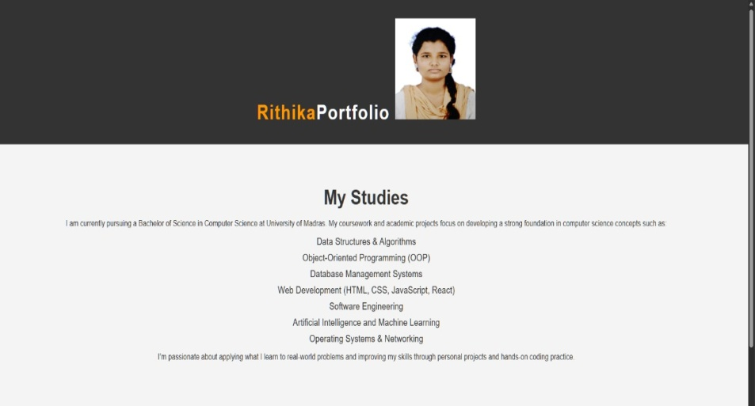

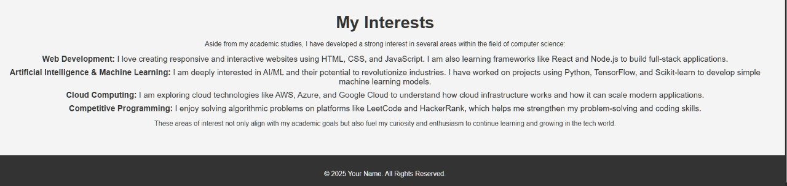
RESULTS AND SCREENSHOTS
3/21/2024 Annual Review
10

Slide 11
CONCLUSION
I'm a passionate and dedicated [your profession, e.g., graphic designer / web developer / photographer] with a strong focus on [key skills or interests, e.g., user-centered design, clean code, or storytelling through visuals]. I enjoy turning ideas into impactful work that speaks for itself. With a mix of creativity, technical skills, and attention to detail, I strive to deliver work that not only meets expectations but inspires.
11

